Slide 1

Invasive Species
The Ladybird’s Tale
IV Southern-Summer School on
Mathematical Biology
Group 4
Deborah Fraga
Lisette Buding
May Anne Mata
Sebastian Graiff
Thales Kronenberger

Slide 2
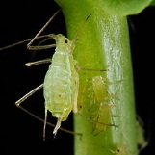
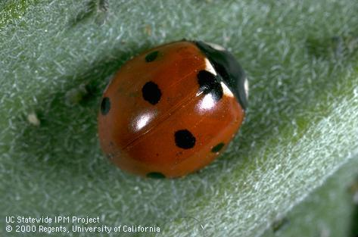
Aphids are insects that parasite plants (Acyrthosiphon pisum)
They are able to reproduce asexually, growing into large populations
Within a food-web, Aphids usually are predated by ladybirds such as the Coccinella septempunctata
Notes:
Aphids population usually has their sizes controlled by ladybird predation by native species such as C. septempunctata

Slide 3
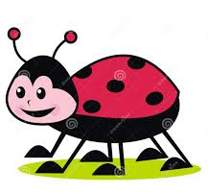
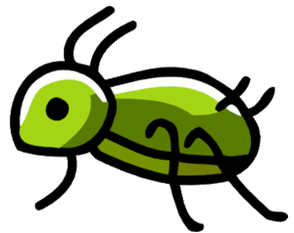
For some regions though,
aphids (A) are pests of the crops
Native species of ladybugs (C) are not able to control their population size

Slide 4
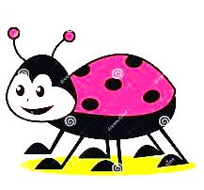
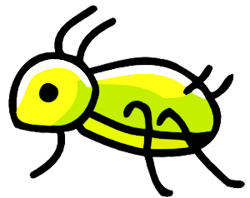
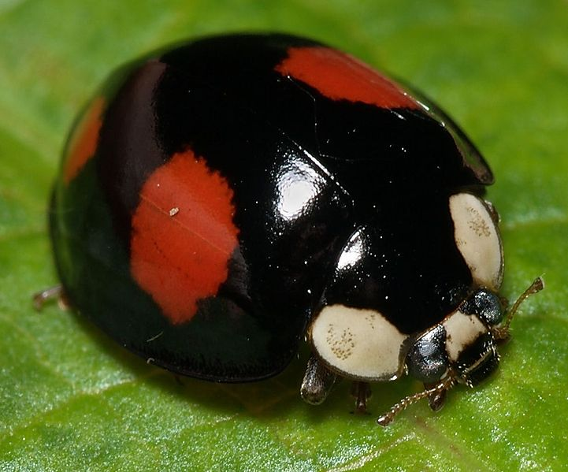
Humans introduced another ladybird species as a biocontrol method, the Harlequin Ladybird
(Harmonia axyridis, H)
Notes:
In Europe and north america the introduced Harmonia axyridis, an asian ladybird, have been used as a biocontrol towards the aphids

Slide 5
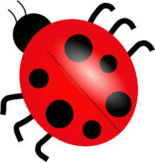
Both ladybird species are now competing for food
Notes:
H.axyridis and C. septempunctata are then predating the aphids population and laying their eggs

Slide 6
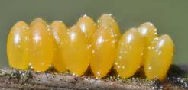
Both ladybird species are now competing for food
Notes:
H.axyridis and C. septempunctata are then predating the aphids population and laying their eggs

Slide 7
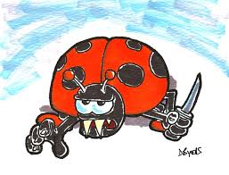
Cannibalism Behaviour
Notes:
As common known for ladybirds in starvation for aphids, their start to eat their own eggs
And, preferably less the eggs of others species

Slide 8
IGP
Notes:
As common known for ladybirds in starvation for aphids, their start to eat their own eggs
And, preferably less the eggs of others species

Slide 9
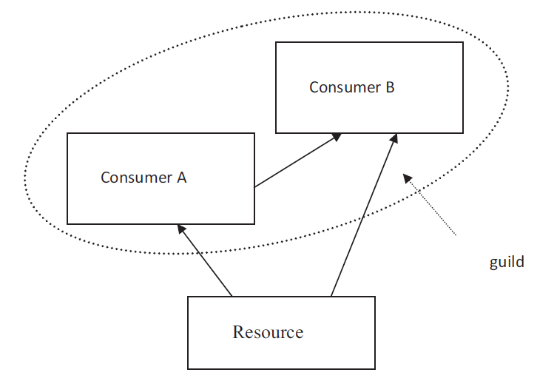
IntraGuild-Predation (IGP):
“the killing and eating of species that use similar, often limiting, resources and are thus potential competitors”
(Polis et al., 1989)

Slide 10
IGP
Notes:
Here at this point, this is how our system looks like, regarding competition for the resource (aphid) and competitors predation (eggs being eaten), which encompasses the IGP and, besides all this we still have to take into account the cannibalism of their own eggs

Slide 11
Harmonia axyridis - features
H. axyridis (H) is able to produce Harmonine
Harmonine increases H resistance against infections
H is infected by Nosema thompsoni
The infection is not harmful for H, but it is mortal to Coccinella
Infection is transmitted through the haemolymph
Notes:
1- Harmonine is an antibiotic substance able to kill several kind of mcgs, being used even as

Slide 12

Notes:
Here at this point, this is how our system looks like, regarding competition for the resource (aphid) and competitors predation (eggs being eaten), which encompasses the IGP and, besides all this we still have to take into account the cannibalism of their own eggs

Slide 13
Notes:
Here at this point, this is how our system looks like, regarding competition for the resource (aphid) and competitors predation (eggs being eaten), which encompasses the IGP and, besides all this we still have to take into account the cannibalism of their own eggs

Slide 14
Main question
Is the infection an important factor for Harlequin ladybird invasion, considering the IGP with C. septempunctata ?
Notes:
1- Harmonine is an antibiotic substance able to kill several kind of mcgs, being used even as

Slide 15
Assumptions of the model
Aphids population growth is logistic with a high carrying capacity
The other populations suffer from a constant death rate
The Egg populations grow from predating aphids, while the Adult populations grow by egg maturation
Ladybirds compete for Aphids (food source)
Adults hunt aphids with different voracities
Infected adult population grows whenever a healthy Harlequin adult eat infected eggs.
If an individual of C. septempunctata population eats an egg it dies immediately

Slide 16



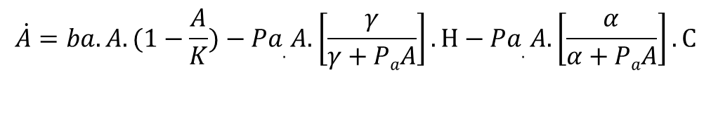


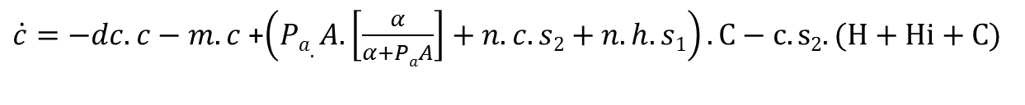
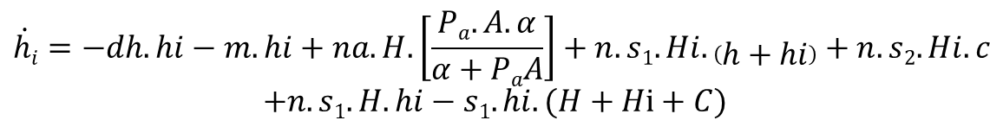
$$\dot{A}=ba.A.(1−\frac{A}{K})−Pa.A.\left[\frac{γ}{γ+PaA}\right].H−Pa.A.\left[\frac{α}{α+PaA}\right].C$$
$$s1=P.e^{−β1.(\frac{A}{H+Hi+C})}$$
$$\dot{H}=−dh.H+m.h−s1.H.hi$$
$$s2=P.e^{−β2. (\frac{A}{H+Hi+C})}$$
$$\dot{Hi}=−dh.Hi+m.hi+s1.H.hi$$
$$\dot{h}=−dh.h−m.h+na.H.\left[\frac{Pa.A.γ}{γ+PaA}\right]+n.s1.H.h+n.s2.H.c−s1.h.(H+Hi+C)$$
$$\dot{hi}=−dh.hi−m.hi+na.H.\left[\frac{Pa.A.α}{α+PaA}\right]+n.s1.Hi.\left(h+hi\right)+n.s2.Hi.c$$
$$+n.s1.H.hi−s1.hi.(H+Hi+C)$$
$$\dot{C}=−dc.C+m.c−s1.C.hi$$
$\dot{c}=−dc.c−m.c$ +$\left(Pa.A.\left[\frac{α}{α+PaA}\right]+n.c.s2+n.h.s1\right).C−c.s2.(H+Hi+C)$

Slide 17
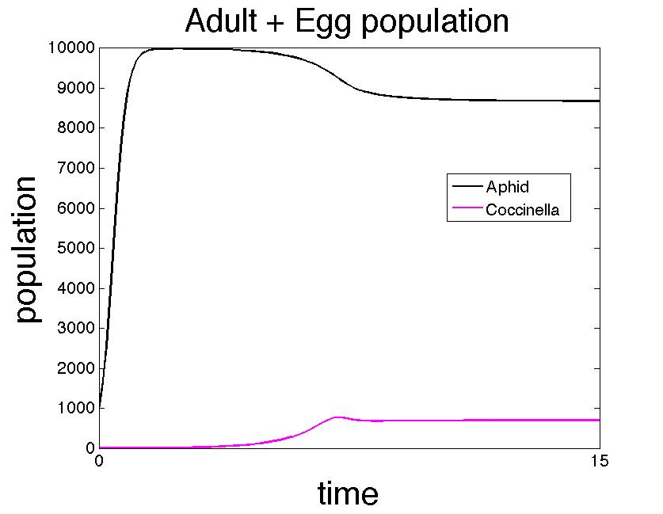
Case 1: Aphids plague
Co=1
Ao=1000

Slide 18
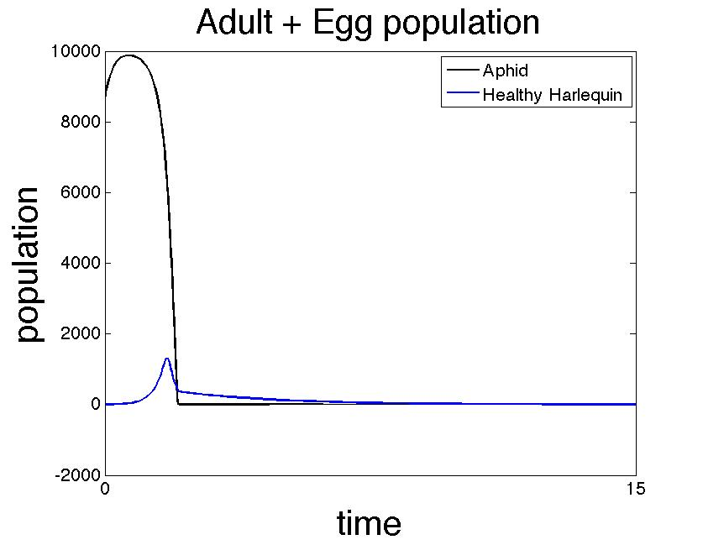
Case 2: Harlequin spreading
Ao=A*=8680
Ho=1

Slide 19
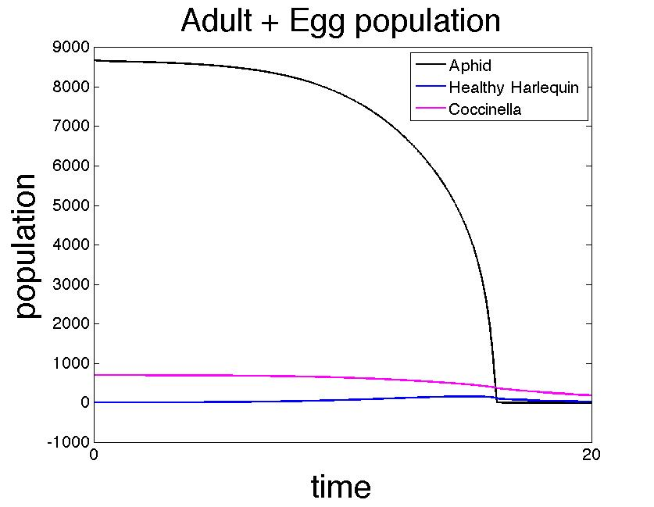
Case 3: IGP effect without the infection
Co=C* =575
co=c*=122
A0=A*=8680
H=1
Notes:
H becomes quickly infected
Hi rises a lot
C dcreases
A decrases
time window as expected!!!

Slide 20
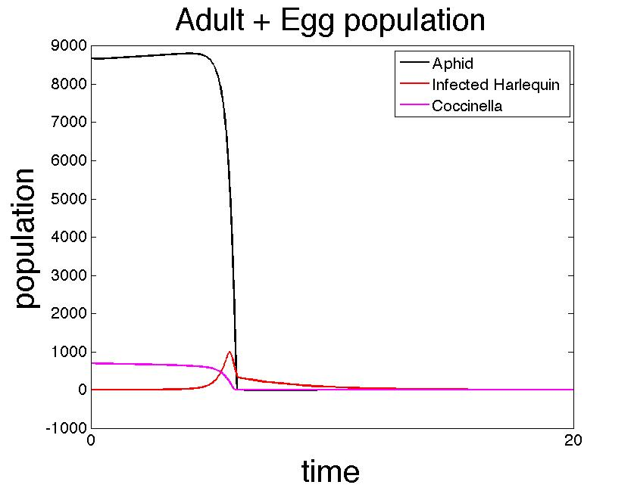
Case 4: Infection effect, population without healthy
Co=C* =575
co=c*=122
A0=A*=8680
Hi=1

Slide 21
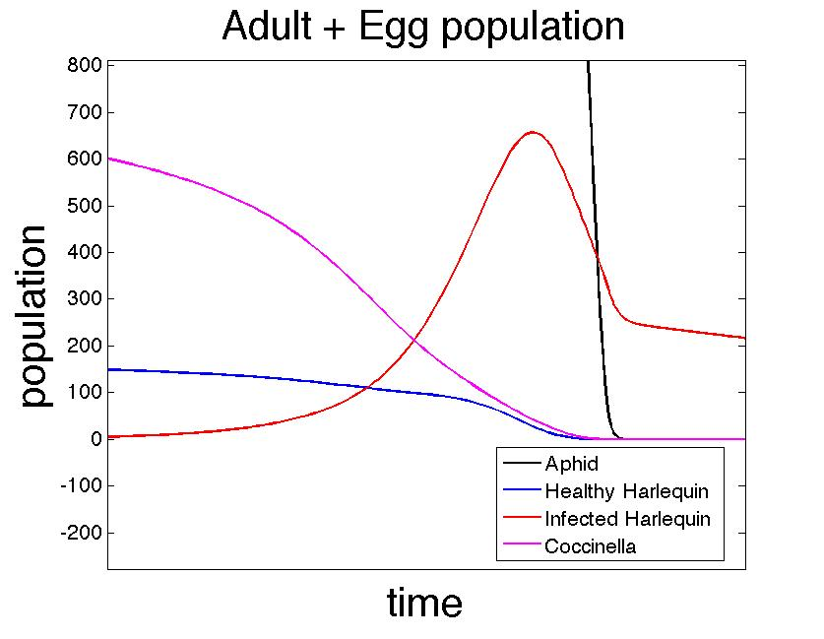
Case 5: Harlequin used as bio-control for aphids
Co=C* =575
co=c*=122
A0=A*=8680
Hi=1
H=100

Slide 22
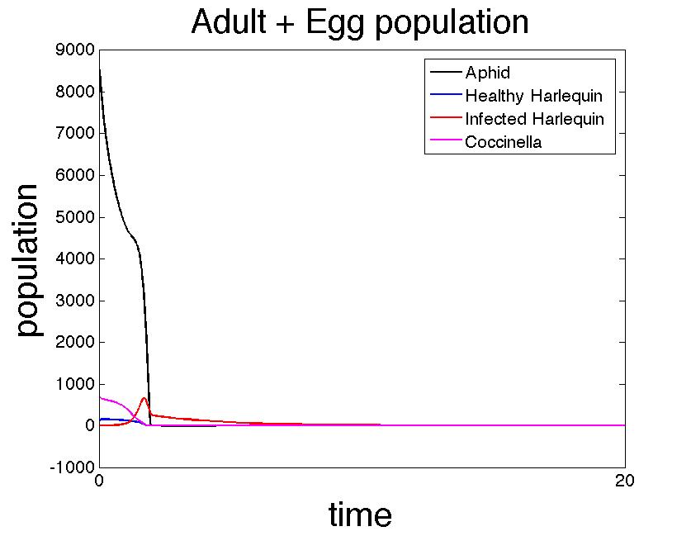
Case 5: Harlequin use as biocontrol for aphids
Co=C* =575
co=c*=122
A0=A*=8680
Hi=1
H=100

Slide 23
Take home message
For a certain set of parameters that reproduces the realistic behaviours, it is not possible for Coccinella septempunctata to survive in the presence of
infected Harlequin.

Slide 24
References
Vilcinskas, A., Stoecker, K., Schmidtberg, H., Röhrich, C. R., & Vogel, H. (2013). Invasive harlequin ladybird carries biological weapons against native competitors. Science, 340(6134), 862-863.
Vilcinskas, A., Stoecker, K., Schmidtberg, H., Röhrich, C. R., & Vogel, H. (2013). Response to Comments on “Invasive Harlequin Ladybird Carries Biological Weapons Against Native Competitors”. Science, 341(6152), 1342-1342.
Stathas GJ, Eliopoulos PA, Kontodimas DC, Giannopapas J. (2001) Parameters of reproductive activity in females of Harmonia axyridis (Coleoptera: Coccinellidae), Eur. J. Entomol. 98 (4): 547-549, 2001
Snyder WE, Sarah B, Joseph RF, Allen JM. (2000) Benefits of Cannibalism for the Lady Beetle Harmonia axyridis (Coleoptera: Coccinellidae) When Prey Quality is Poor. Entomological Society of America.

Slide 25
Thank you
Questions?

Slide 26
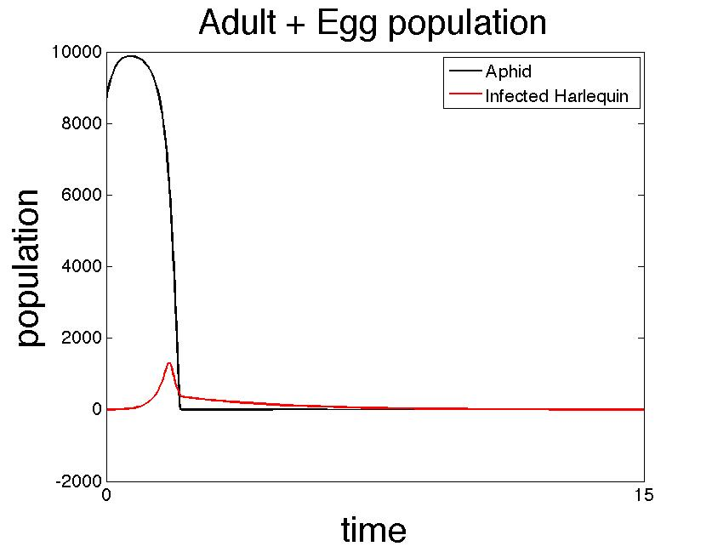
Case 2 - EXTRA: Hi eliminates aphids

